Slide 1

Department of Computer Science & Engineering (Artificial Intelligence & Machine Learning)
A.P. Shah Institute of Technology
G.B.Road, Kasarvadavli, Thane(W), Mumbai-400615
UNIVERSITY OF MUMBAI
Academic Year 2022-2023

Slide 2






PREDICTOR:
Implementation of Vedic Astrology
Computer Science & Engineering
Artificial Intelligence and Machine Learning
By-
Kapil Surve (21106018)
Sridev Nayak (21106059)
Shreyash Wadalkar(211060)
A Sem4 Mini-Project
Under the Guidance of
Prof. Mahesh Pawaskar

Slide 3
Index:
Introduction
Objectives
Literature Survey
Block Diagram
Tools/Softwares, Languages used
Implementation
Conclusion
References

Slide 4
Introduction
1.At least once in a life time you must have read kundali or birthchart ,To read a kundali we need a Jyotisha/Astrologer they can easily give insights on your future and past by reading your birth chart and can give accurate predictions on it .
2.From Ancient times the concept of Astrology was core part of indian culture it was common practice among The Greatest of Scholars
3.In this Modern Era this practice was in someway lowshaded because various myths &Propaganda against Indic Culture .And also because of nearly sheer amount of scams running on this subject.
4.To avoid such instances and benifiting the society from our ancient knowledge we bring our Project "The Predictor :Implementation of Vedic Astrology"

Slide 5
Objectives
To Provide User an Unbiased Kundali Predictions
Analyzing Birth Chart for Possible Events
One can find Education Choices
One can get suggestions for his problems
One can know about his True Self
One can know about their Soul mate
Generated Prediction Report on your Job ,Income and Opportunities.
Provides you with predictions of your Family,Friends and Martial ConditionS

Slide 6
Literature Survey
Sr no | Title | Author | Description
1. | Predictive role of case based reasoning for astrological predictions about profession: system modeling approach. | Rishi, O. P., and Neelam Chaplot | This paper describes the research in the field of astrology using case based reasoning method of artificial intelligence. Most typical aspect of astrology is the rules on which prediction is done in this science. Rules are defined by experienced persons in the field of astrology by identifying the similarity between the past cases which they have encountered.
2. | Analysis of Vedic astrology and scientific calculation through orbital period | Sharma, Harsh, Naveen Rao, and Mohit Sharma | Indian Astrology is old as Indian civilization and gets developed time to time. From so long time (B.C.) Indian civilization had unit like degree and minute (as Ansha & Kala) to measure the angular distances. But in present time people connect astrology only with the spirituality not with science. . This paper describe the calculations which astrology use to show planetary movement and those scientific calculations which prove them.

Slide 7
Literature Survey
Sr no | Title | Author | Description
3. | Archetype of astrological prediction system about profession of any persons' using case based reasoning | O. P. Rishi and N. Chaplot | In the present scenario of the civilization, nearly one third of the population around the world Knows astrology and the rest of the two third cares enough to attend to astrological prediction at least some or other time. Beside this, a very few percent so called progressive people refuse the astrology just because of its un-standardized rules and its prediction is based on reasoning by analogy. In the present day scenario astrology needs a scientific reasoning and scientific computational model to establish the well known facts of this popular subject
4. | Astrology in the early modern period : practices and concepts | Steven Vanden Broecke (UGent) | astrology was a robust part of Europe's philosophical traditions. Firmly wedded to mathematics and natural philosophy, it was the need to secure astrology's prognostic capabilities which often drove the emergence of modern approaches to astronomy.

Slide 8
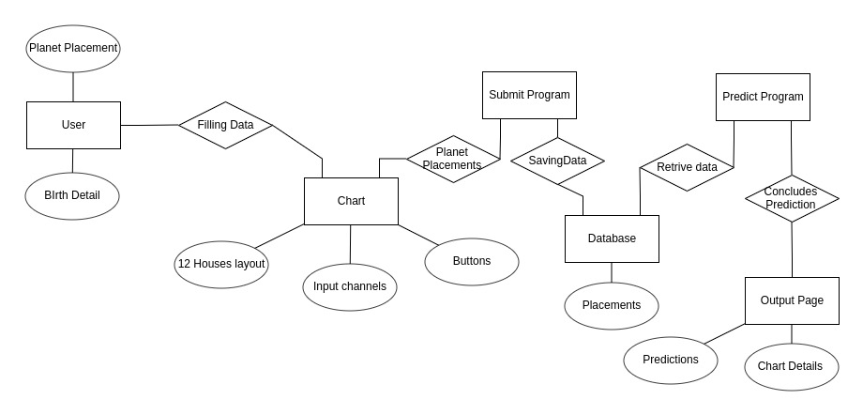
Block Diagram

Slide 9





Tools & Software Used
HTML
CSS
JAVASCRIPT
VSCODE
MYSQL

Slide 10

Implementation
Access Page:

Slide 11
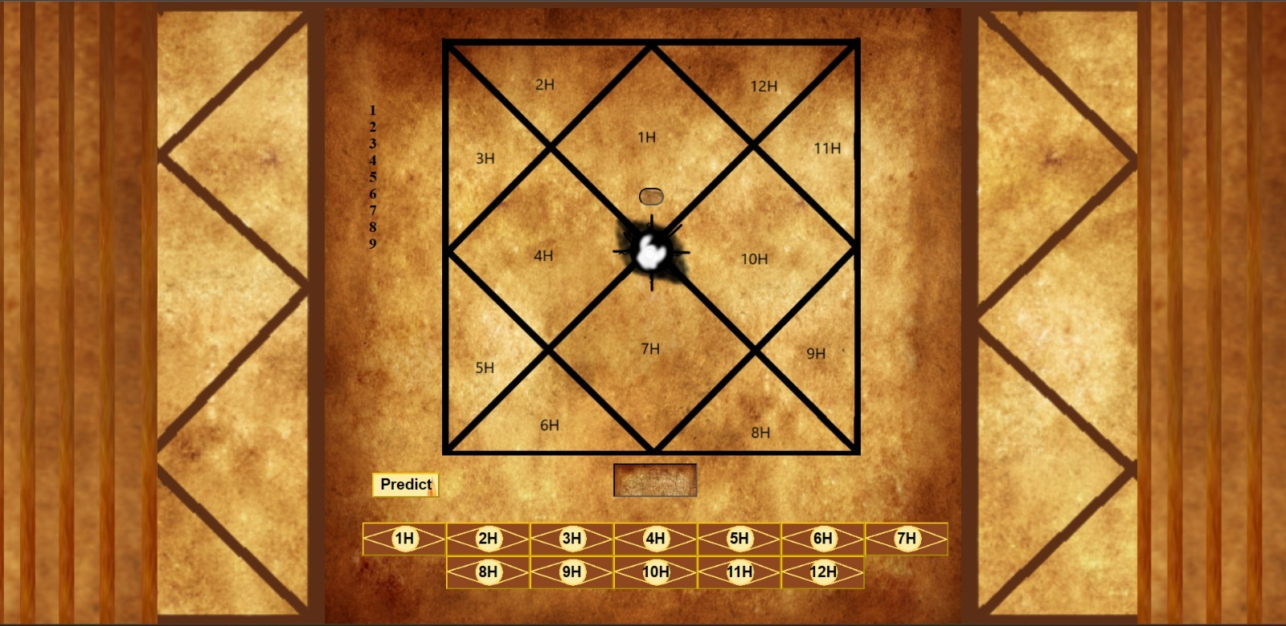
Implementation
Chart Page:

Slide 12
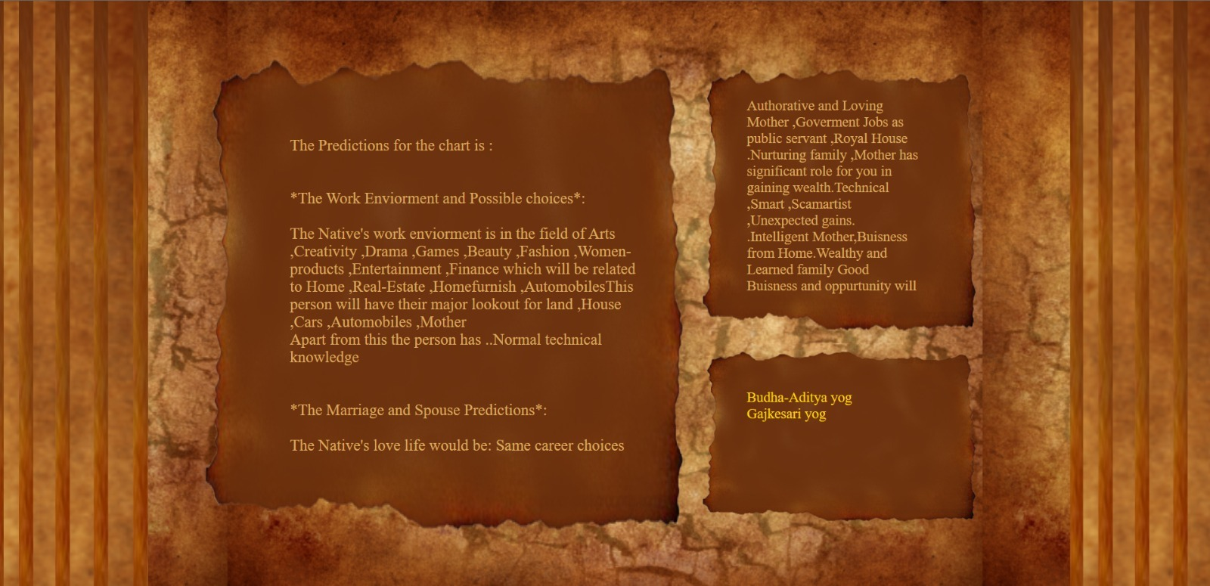
Implementation
Report Page:

Slide 13
Conclusion
We have Succesfully completed the project . Entire process was a learning experience which was confronted with surely many challenges .with an considerable amount of fame from the masses ,This Project was dSisplayed
At our technical event “Exalt” We Recieved positive reviews and further improvision was done as per need of Students.
This project has greater scope in future and can create significant changes in this Times

Slide 14
References
Websites :
https://www.astroyogi.com/kundli
https://www.prokerala.com/astrology/birth-chart
https://astrology.community/
https://vidhyamitra.com/
Books:
RD.Jyotishshastra
Yajur-Veda
Panini Vedic Astrology
Aspects in the speed of light

